Slide 1

E-Commerce payment system
Author: Swetha Ravindra
Date : 16/11/22

Slide 2
Agenda
    Introduction
    Requirement Change
    Team Discussions on Requirement
    Brief Project Plan
    Requirement Traceability Matrix
    Risk & Mitigation
    Q&A

Slide 3
Introduction
An E-Commerce payment system facilitates the acceptance of electronic payment for online transactions. E-Commerce systems have become increasingly popular with widespread use of the internet-based shopping and banking.
If E-commerce technologies are used to accept payments , PCI DSS ( Data Security Standards) requirements apply to those technologies.
PCI – Payment Card Industry Data Security Standard that helps businesses process card payments securely and reduce card fraud. There needs to be tight controls on storage, transmission and processing of cardholder data that businesses handle.
The Merchant and third-party service provider are responsible to ensure PCI DSS is adhered to and payment card data is protected.
The E-commerce payment systems , specific controls and procedure will vary for each environment according to how it handles payment processing.

Slide 4
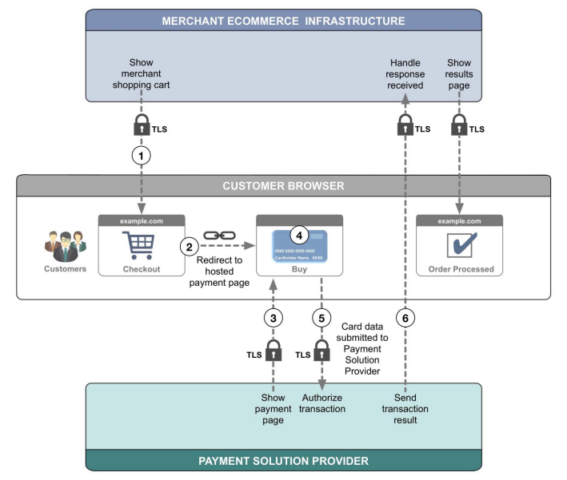
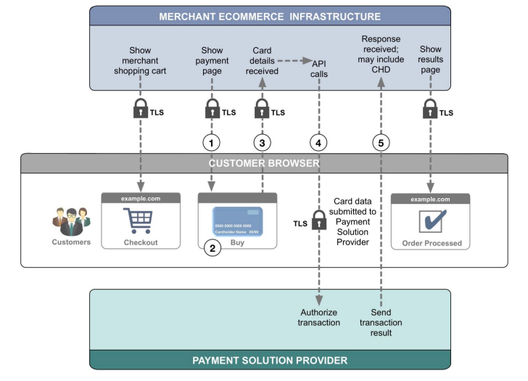
Requirement Change
Source : www.pcisecuritystandards.org

Slide 5
Team Discussions on Requirement
Get to know the team (stakeholders).
Understand how the current functionality with secure checkout works? – Walk through
Schedule meeting with the company stakeholders to plan out the elicitation, review, validation and analyse the need for change from the current procedure.
Current Architecture to checkout system?
Understand the pain points in the current payment process?
Understanding of the payment provider current agreement, payment process, authentication and confirmation on successful/failed transactions from the Business subject matter expertise.

Slide 6
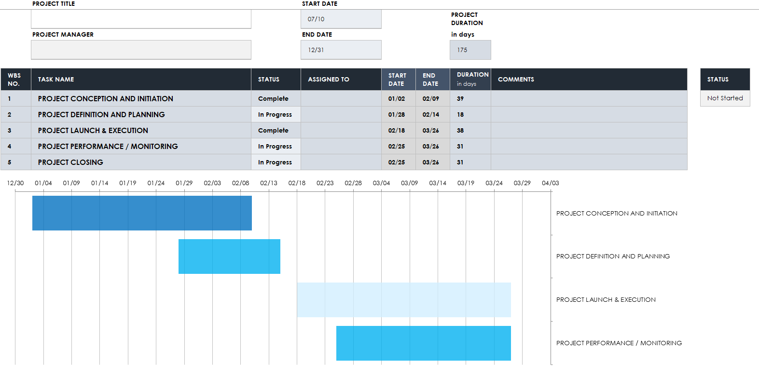
Project Plan

Slide 7
Requirement Traceability Matrix
REQUIREMENT INFORMATION |  |  |  |  | RELATIONSHIP TRACEABILITY
ID | CATEGORY | REQUIREMENT | PRIORITY | SOURCE | Requirement Type | DELIVERABLE(S | VALIDATION | Status
REQ-001 | Mandatory | PSP API integration | High | CTO /Architect | Technical |  | Unit/Integration/UAT testing | WIP
REQ-002 |  | Mapping requirements on dd/mm/yyyy format, amount, currency, file attachment. | Medium | Architect |  |  | Unit/Integration/UAT testing | WIP
REQ-003 | Mandatory | Impact on existing Customer registration process (user friendly) | High | Product Owner | Functional |  | Unit/Integration/UAT testing | WIP
REQ-004 | Mandatory | Customised checkout pages with delivery address (existing customer) and payment method for registered customers/potential buyers | Medium | Product Owner | Functional |  | Unit/Integration/UAT testing | WIP
REQ-005 | Mandatory | making checkout procedure easy for customer registering/logging in for the first time (User-friendly). | High | Product Owner | Functional |  | Unit/Integration/UAT testing | WIP
REQ-006 | Mandatory | Device Compatibility | Medium | Architect | Functional |  | Unit/Integration/UAT testing | WIP
REQ-007 | Mandatory | Browser compatibility with payment form display | Medium | Architect | Functional |  | Unit/Integration/UAT testing | WIP
REQ-008 | Mandatory | KYC (Know your Customer) Compliance | High | Product Owner/Compliance team | Service |  | Unit/Integration/UAT testing | WIP
REQ-009 | Should-Have | The customer enters cardholder data into the payment form and the data is sent to PSP API (tbc on SAQ A or SAQ A - EP) | Blocked | Product Owner/Finance/Compliance | Non-Functional |  | Unit/Integration/UAT testing | WIP
REQ-010 | Mandatory | The PSP receives cardholder data and sends it to the payment system for authorisation. | Medium | PSP/Architect | Functional |  | Unit/Integration/UAT testing | WIP
REQ-011 | Should-Have | Security controls - prevent any malicious attack. | High | Cyber Security Team/Architect | Non-Functional |  | Unit/Integration/UAT testing | WIP
REQ-012 | Mandatory | Transactions confirmation on successful /failed transactions. | High | Architect/Technical Team | Functional |  | Unit/Integration/UAT testing | WIP
REQ-013 | Should-Have | Reconcialition on customer transactions. | High | Service Desk | Service |  | Unit/Integration/UAT testing | WIP
REQ-014 | Mandatory | Integration with internal systems SAP Billing and CMS | High | Architect/PO | Non-Functional |  | Unit/Integration/UAT testing | WIP
REQ-015 | Should-Have | Customer experience rating | Medium | Product Owner | Functional |  | Unit/Integration/UAT testing | WIP
REQ-016 | Nice-To-Have | Live-Chat | Low | Architect/Service Desk | Functional |  | Unit/Integration/UAT testing | WIP

Slide 8
Risk & Mitigations
SL No | Risk | Mitigation
1 | Requirements and UX Designs may not be ready prior to begin of the sprint. | Requirement review meetings twice a week with PO's and DEV's to ensure designs are ready.
2 | Employee1 will be out of office for 2 weeks. | Employee2 will be covering Employee1 in his absence.
3 | UX Design might change after Dev starts. | UX Design walk through delivered by PO to the DEV teams.
4 | Initial sizing of features are based on 'T-Shirtsizes’ guestimates. Actual estimates might vary. | Employee3 will be re-evaluating the stories to see if any of them can be de-scoped or prioritised lower. Employee 4 will be reviewing 'Continuous Improvement' to see if it can de-scoped.
5 | Team X and Team Y are relatively new teams. Their velocity will be low. | Team support and on the job, training will be provided.
6 | Possible situation of 2 contractors to be removed in October. The team size will reduce | Team members from other team will be let into the team for additional support.
7 | Uncertain Covid-19 situation, Company policy change and unforeseen redundancy and Government policies on businesses. | TBD with the subject matter expertise(SME) on timelines and to assess the situation.

Slide 9


